Slide 1

Chapter 10
Error Detection
and
Correction
10.<number>
Copyright © The McGraw-Hill Companies, Inc. Permission required for reproduction or display.

Slide 2

Note
Data can be corrupted
during transmission.
Some applications require that
errors be detected and corrected.
10.<number>

Slide 3
10-1 INTRODUCTION
Let us first discuss some issues related, directly or indirectly, to error detection and correction.
Topics discussed in this section:
Types of Errors
Redundancy
Detection Versus Correction
Forward Error Correction Versus Retransmission
Coding
Modular Arithmetic
10.<number>

Slide 4
Note
In a single-bit error, only 1 bit in the data unit has changed.
10.<number>

Slide 5
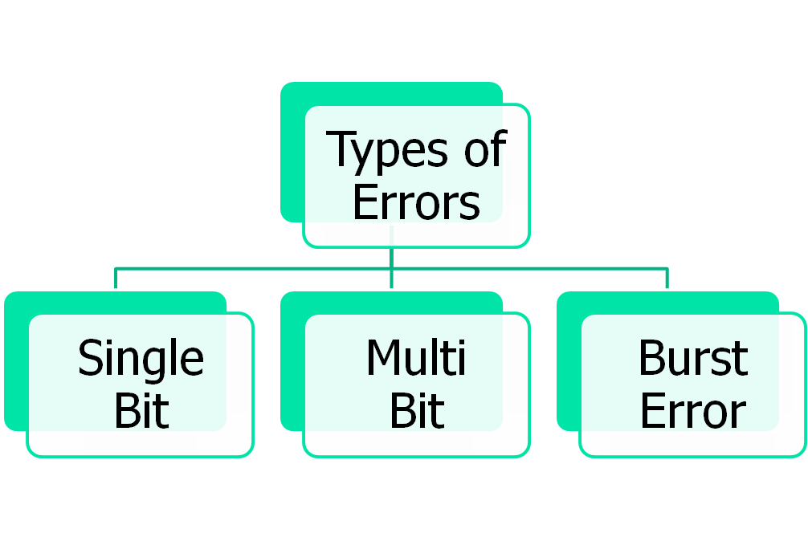
10.<number>

Slide 6

Figure 10.1 Single-bit error
10.<number>

Slide 7
Note
A burst error means that 2 or more bits in the data unit have changed.
10.<number>

Slide 8

Figure 10.2 Burst error of length 8
10.<number>

Slide 9
Note
To detect or correct errors, we need to send extra (redundant) bits with data.
This is called Redundant Bit.
10.<number>

Slide 10
Detection versus Correction
The correction of errors is more difficult than the detection.
In detection, only check is made if error is present? Answer is simple, yes or no.
In correction, once the check is made and error is detected, it also locates the error. Answer is additional information of location of error to perform correction.
10.<number>

Slide 11
Coding
Redundancy is achieved through various coding schemes.
We can divide coding schemes into two broad categories: block coding and convolution coding.
Our concentration will be on block coding only.
To perform coding, we need encoding and decoding which is shown in next figure.
The receiver can detect error/ a change in the original codeword, if it follows these two conditions:
1. The receiver has (or can find) a list of valid codewords.
2. The original codeword has changed to an invalid one
10.<number>

Slide 12

Figure 10.3 The structure of encoder and decoder
10.<number>

Slide 13

Figure 10.4 XORing of two single bits or two words
10.<number>

Slide 14
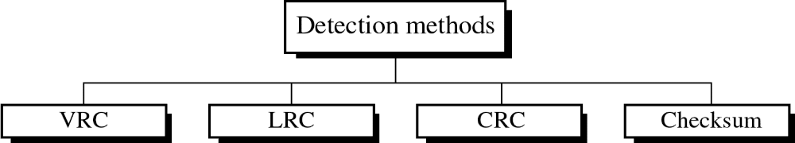
Detection Methods:
Detection methods
  VRC(Vertical Redundancy Check)
  LRC(Longitudinal Redundancy Check)
  CRC(Cyclical redundancy Check)
  Checksum

Slide 15
VRC
VRC(Vertical Redundancy Check)
  A parity bit is added to every data unit so that the total number of 1s(including the parity bit) becomes even for even-parity check or odd for odd-parity check
  VRC can detect all single-bit errors.
  It can detect multiple-bit or burst errors only the total number of errors is odd.
Even parity VRC concept is given in next fig

Slide 16
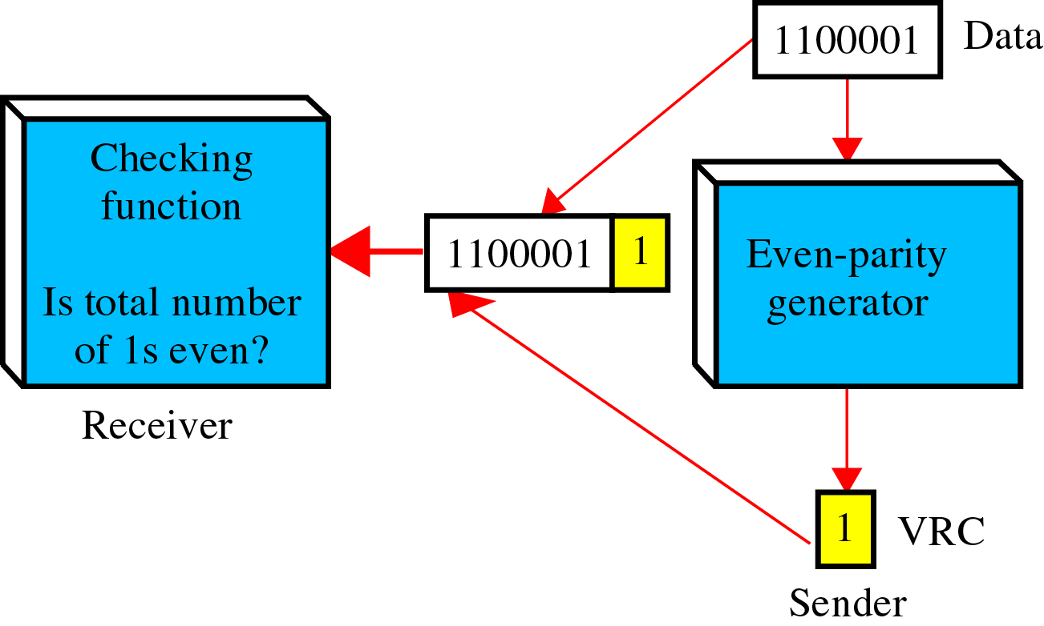
VRC

Slide 17
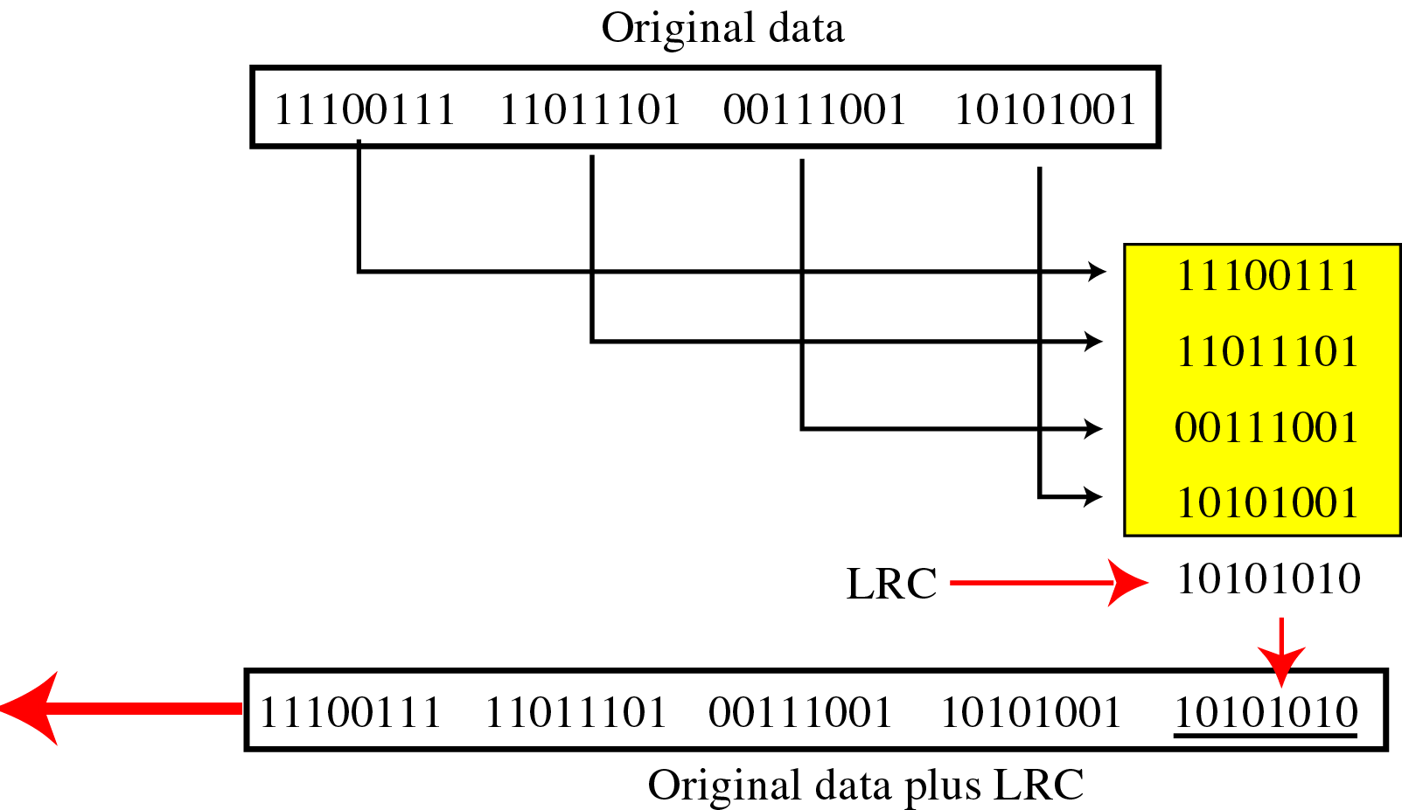
LRC
LRC(Longitudinal Redundancy Check)
  Parity bits of all the positions are assembled into a new data unit, which is added to the end of the data block

Slide 18
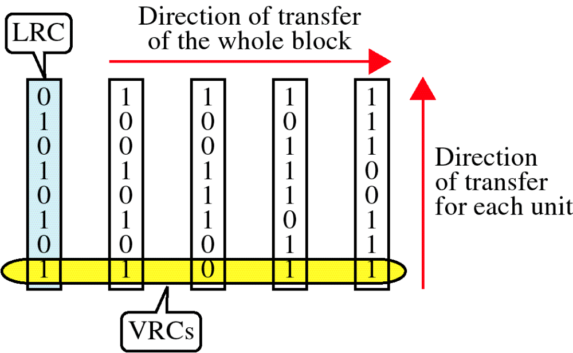
VRC & LRC

Slide 19
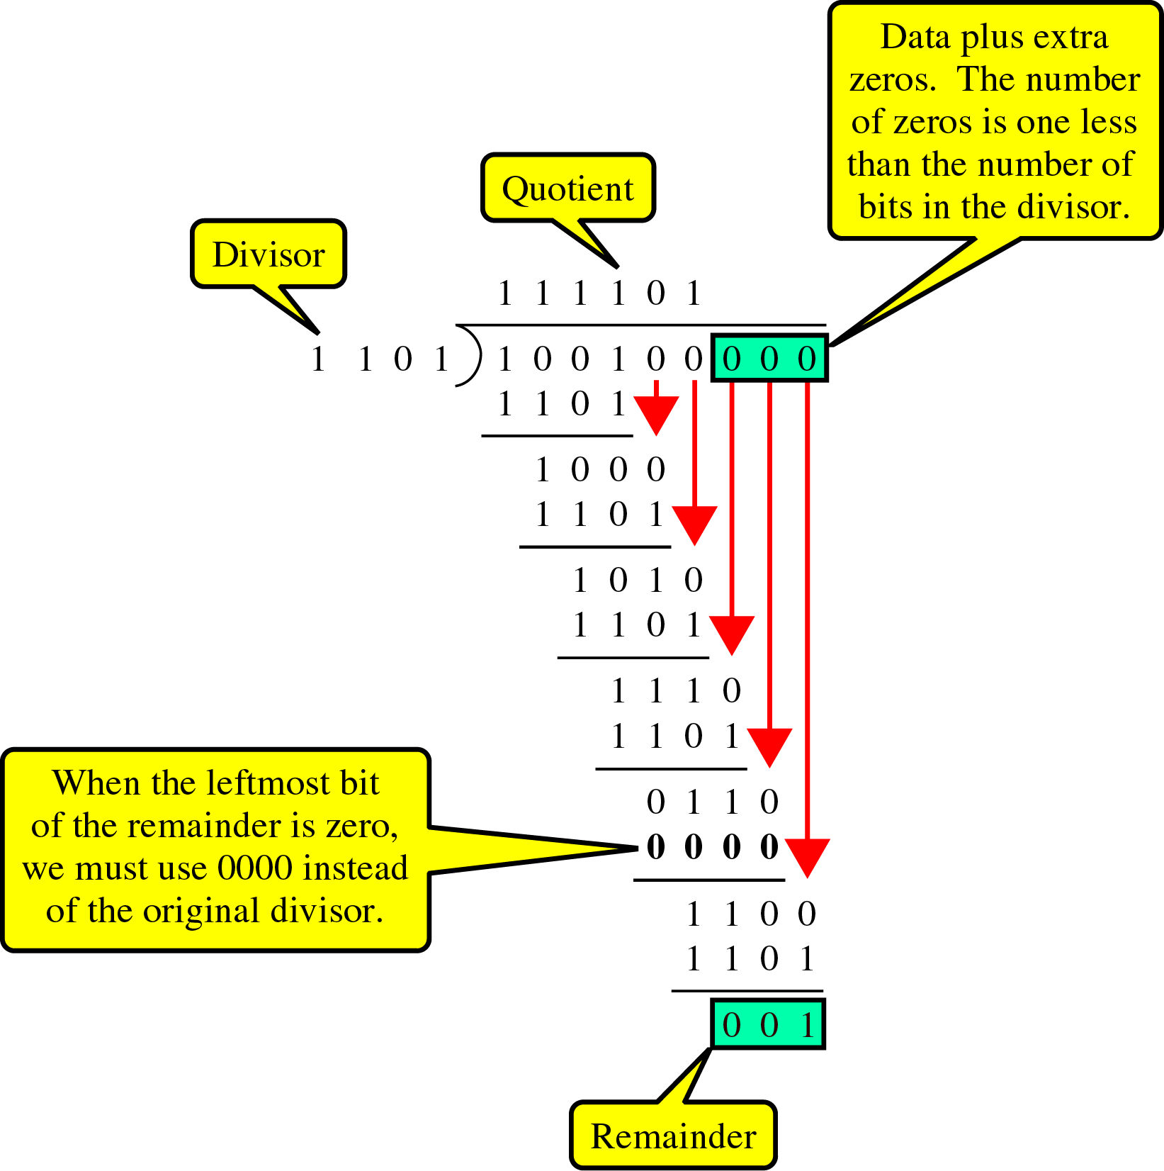
CRC Generator
CRC generator
uses modular-2 division.
Binary Division
in a CRC Generator

Slide 20
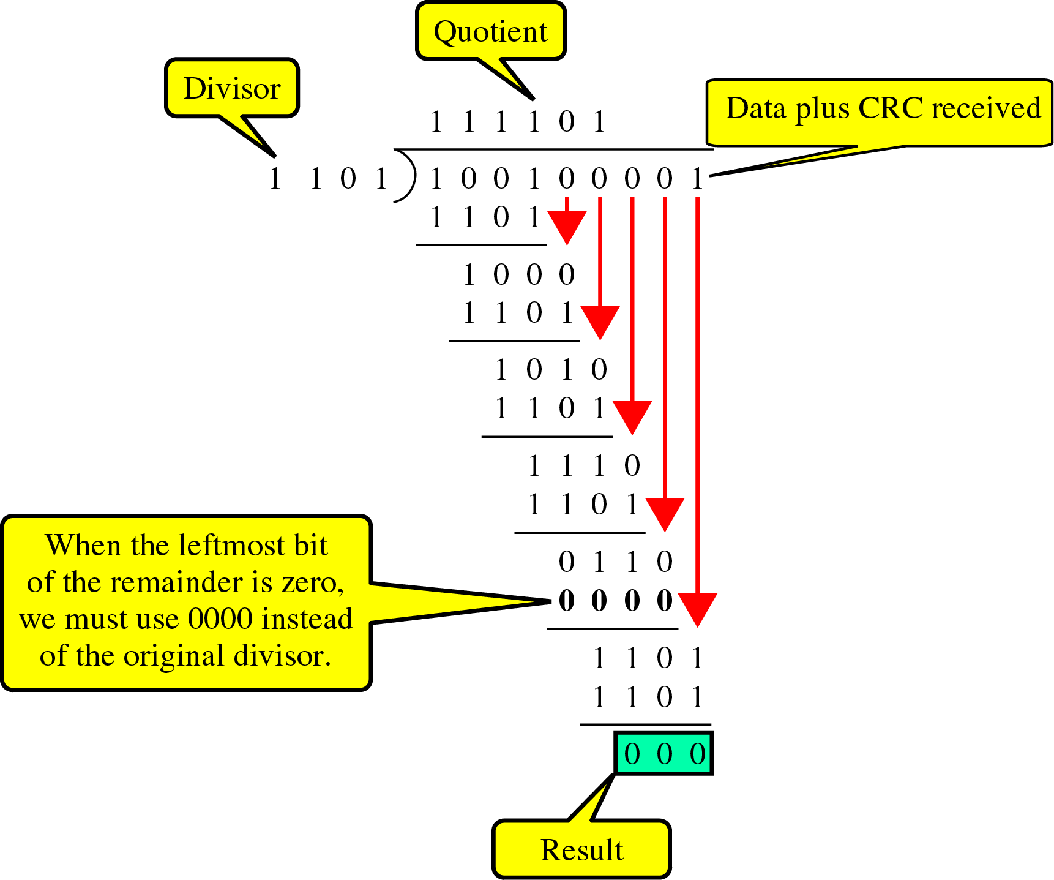
CRC Checker
Binary Division
in a
CRC Checker

Slide 21
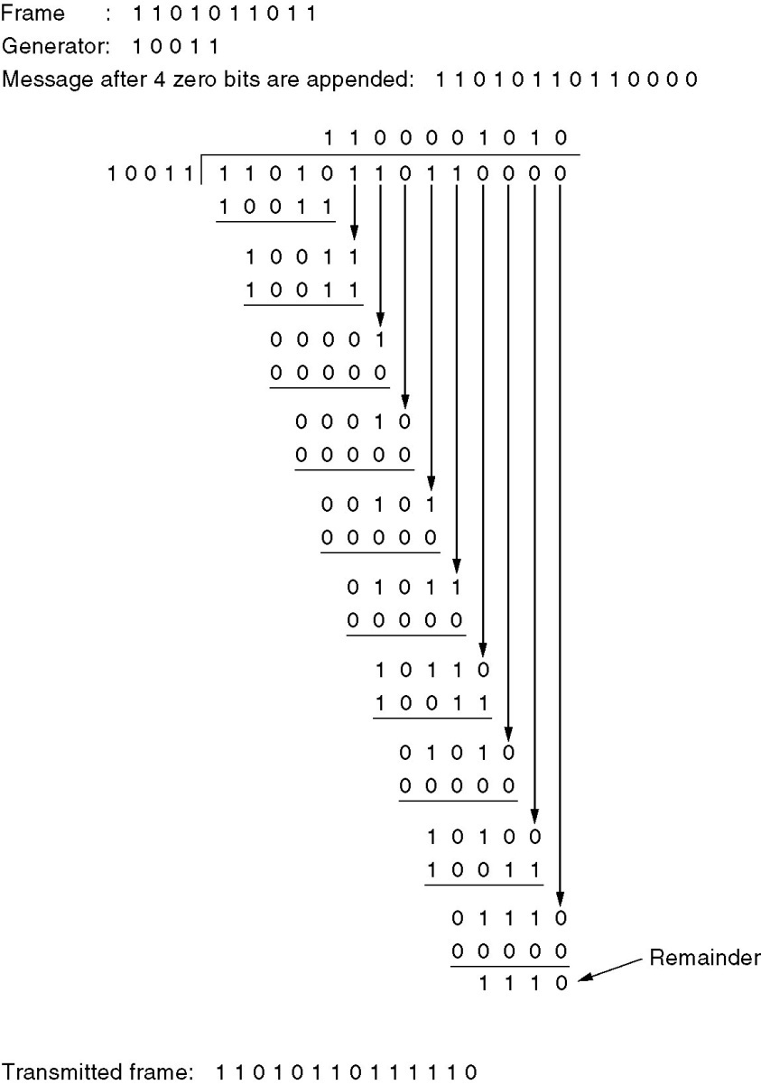
One more example
Calculation of the polynomial code checksum.

Slide 22
Checksum:
Checksum is used by the higher layer protocols
And is based on the concept of redundancy(VRC, LRC, CRC …. Hamming code)
To create the checksum the sender does the following:
  The unit is divided into K sections, each of n bits.
  Section 1 and 2 are added together using one’s complement.
  Section 3 is added to the result of the previous step.
  Section 4 is added to the result of the previous step.
  The process repeats until section k is added to the result of the previous step.
  The final result is complemented to make the checksum.

Slide 23
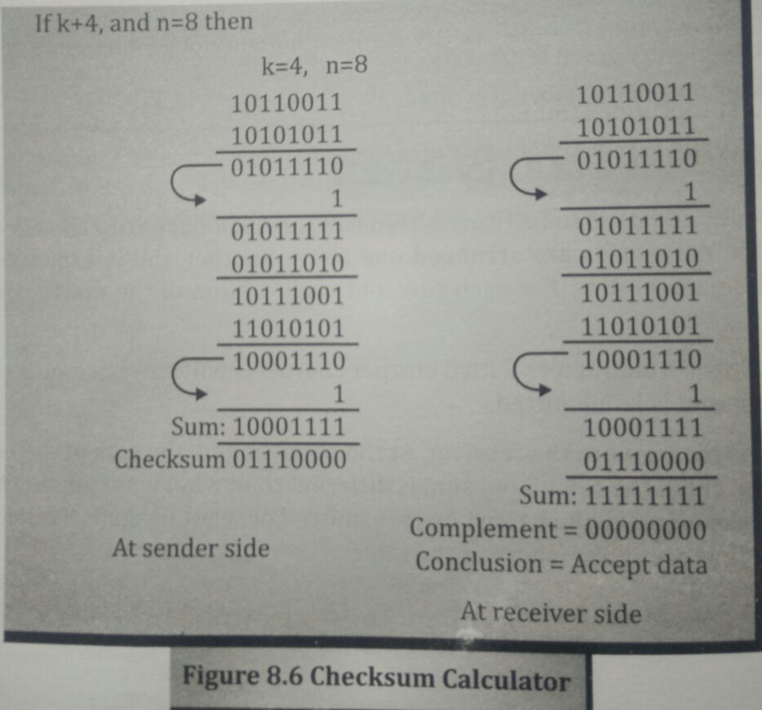
Checksum Example

Slide 24
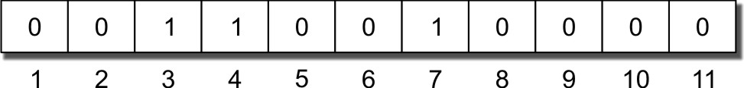
Hamming code and Error
Redundancy for error handling
m data bits and r redundant bits
for m + r bits only one correct value of r for a given m
one correct bit pattern requires m + r incorrect patterns
m + r + 1 < 2 ^{r}
7 bit data 4 bit redundant bits makes it 11

Slide 25
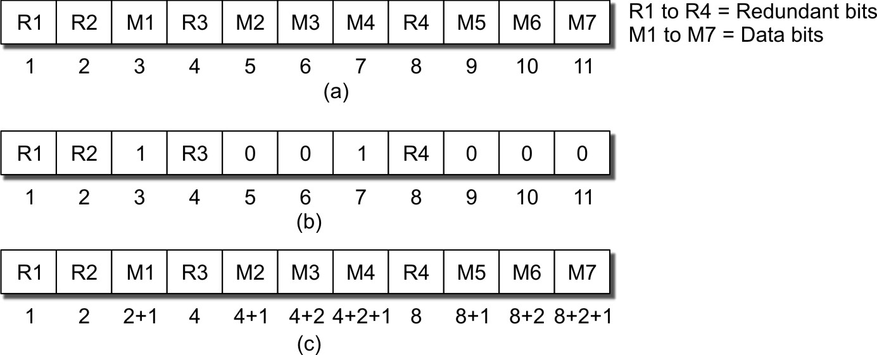
Hamming code calculations

Slide 26
R1,R2,R3 and R4 calculations
R1 represents the parity of M1, M2, M4, M5, and M7 = M1 + M2 + M4 + M5 + M7 = 1 + 0 + 0 + 1 + 0 + 0 = 0
R2 represents the parity of M1, M3, M4, M6, and M7 = 1 + 1 + 0 + 0 =0
R3 represents the parity of M2, M3, and M4=1
R4 represents the parity of M5, M6, and M7=0

Slide 27
Error Correction Using
Hamming Code
Can be handled in two ways:
when an error is discovered, the receiver can have the sender retransmit the entire data unit.
a receiver can use an error-correcting code, which automatically corrects certain errors.
Hamming Code
~ developed by R.W. Hamming
positions of redundancy bits in Hamming code, lets see how.
each r bit is the VRC bit for one combination of data bits
  r₁ = bits 1, 3, 5, 7, 9, 11
  r₂ = bits 2, 3, 6, 7, 10, 11
  r₄ = bits 4, 5, 6, 7
  r₈ = bits 8, 9, 10, 11

Slide 28
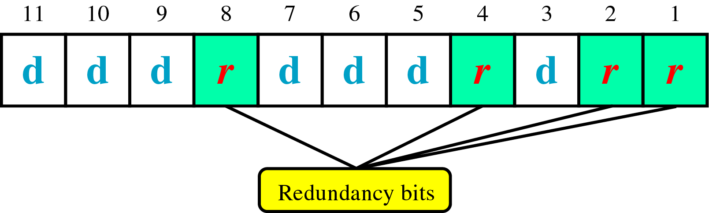
Redundant Bit Position

Slide 29
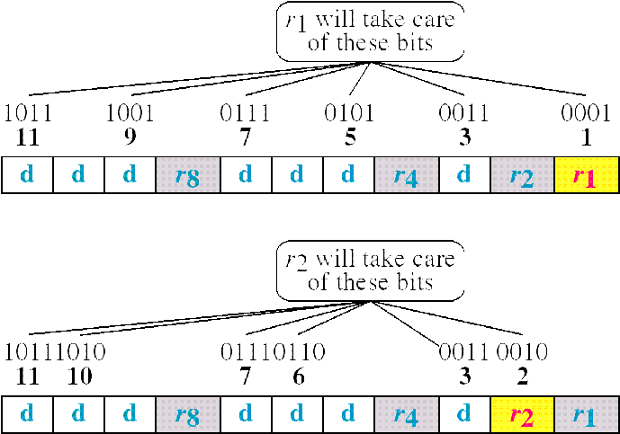

Slide 30
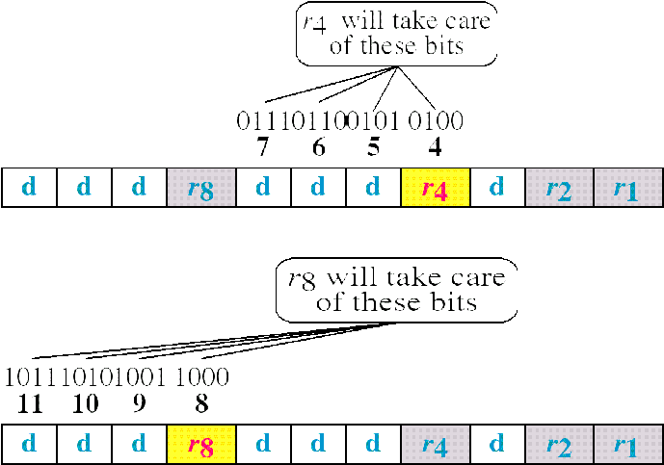

Slide 31
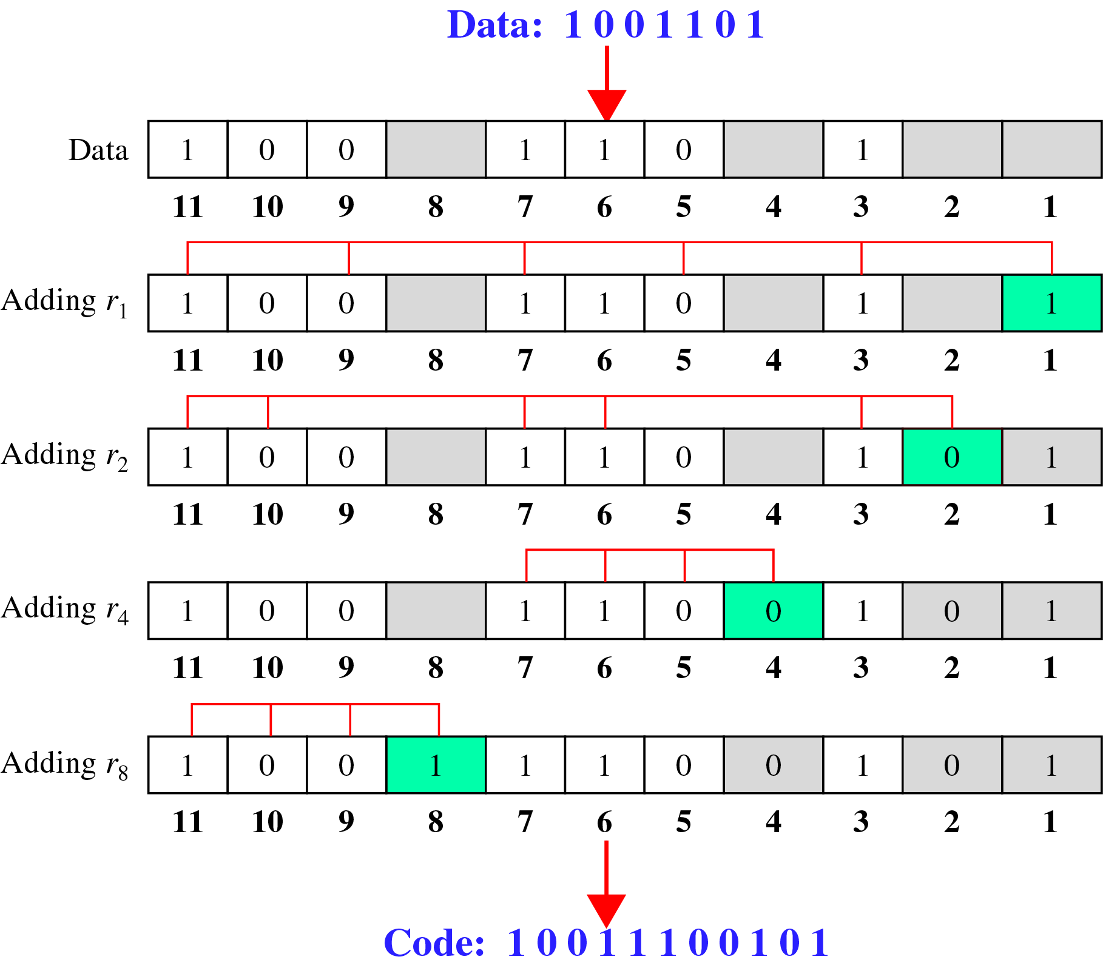
Calculating the r values
Calculating Even Parity

Slide 32
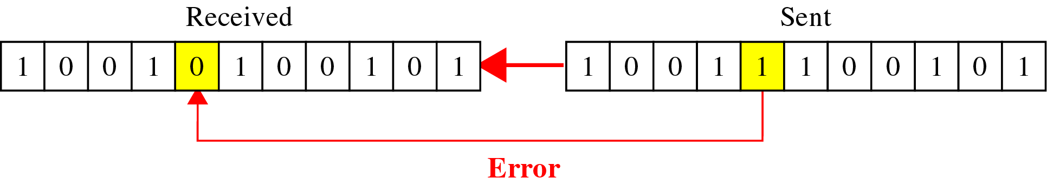
Example:

Slide 33
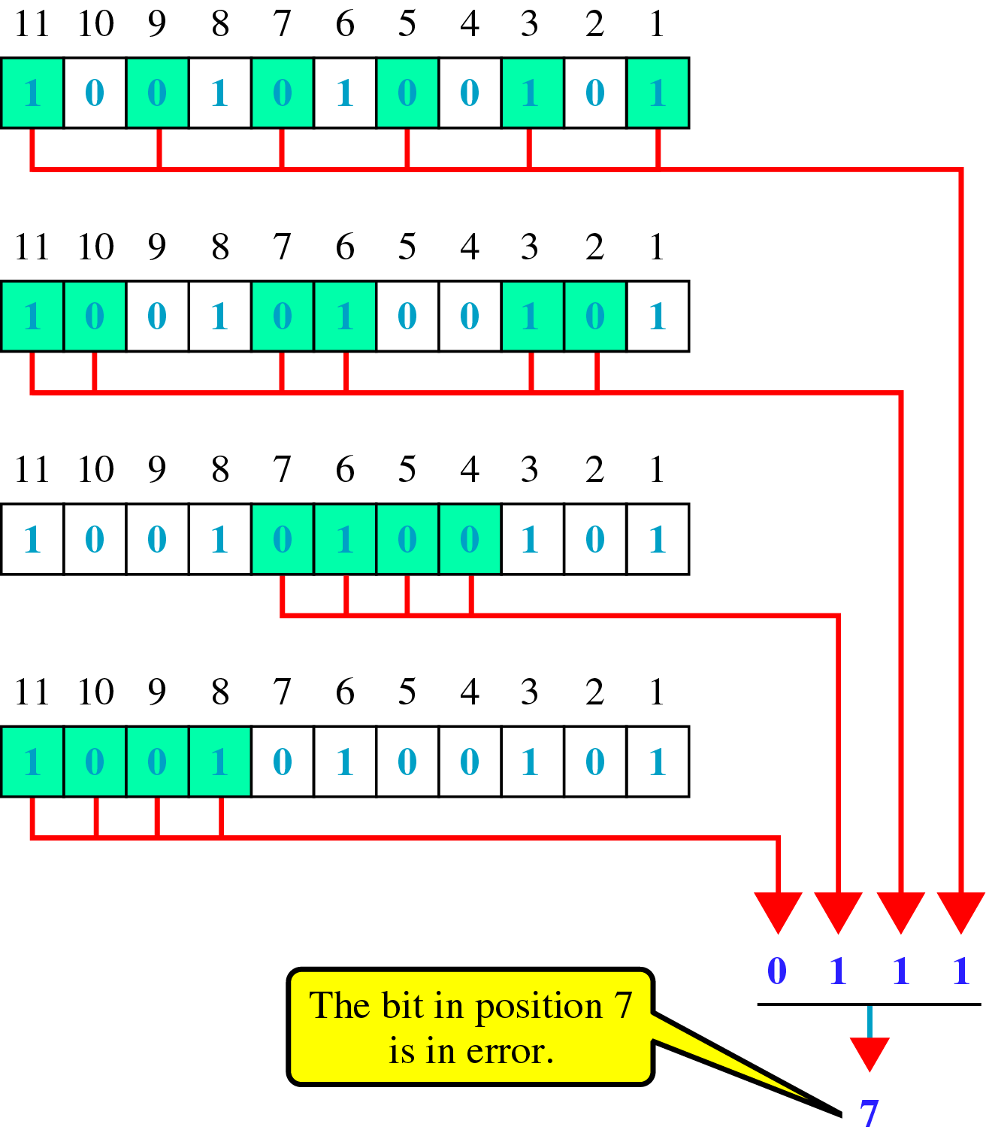
Error Detection Using Hamming Code:

Slide 34
10-2 BLOCK CODING
In block coding, we divide our message into blocks, each of k bits, called datawords. We add r redundant bits to each block to make the length n = k + r. The resulting n-bit blocks are called codewords.
Topics discussed in this section:
Error Detection
Error Correction
Hamming Distance
Minimum Hamming Distance
10.<number>

Slide 35

Figure 10.5 Datawords and codewords in block coding
10.<number>

Slide 36

Figure 10.6 Process of error detection in block coding
10.<number>

Slide 37
Example 10.2
Let us assume that k = 2 and n = 3. Table 10.1 shows the list of datawords and codewords. Later, we will see how to derive a codeword from a dataword.
Assume the sender encodes the dataword 01 as 011 and
sends it to the receiver. Consider the following cases:
1. The receiver receives 011. It is a valid codeword. The
receiver extracts the dataword 01 from it.
10.<number>

Slide 38
Example 10.2 (continued)
2. The codeword is corrupted during transmission, and
111 is received. This is not a valid codeword and is
discarded.
3. The codeword is corrupted during transmission, and
000 is received. This is a valid codeword. The receiver
incorrectly extracts the dataword 00. Two corrupted
bits have made the error undetectable.
10.<number>

Slide 39

Table 10.1 A code for error detection (Example 10.2)
10.<number>

Slide 40
Note
An error-detecting code can detect
only the types of errors for which it is designed; other types of errors may remain undetected.
10.<number>

Slide 41

Figure 10.7 Structure of encoder and decoder in error correction
10.<number>

Slide 42
Example 10.3
Let us add more redundant bits to Example 10.2 to see if the receiver can correct an error without knowing what was actually sent. We add 3 redundant bits to the 2-bit dataword to make 5-bit codewords. Table 10.2 shows the datawords and codewords. Assume the dataword is 01. The sender creates the codeword 01011. The codeword is corrupted during transmission, and 01001 is received. First, the receiver finds that the received codeword is not in the table. This means an error has occurred. The receiver, assuming that there is only 1 bit corrupted, uses the following strategy to guess the correct dataword.
10.<number>

Slide 43
Example 10.3 (continued)
1. Comparing the received codeword with the first codeword in the table (01001 versus 00000), the receiver decides that the first codeword is not the one that was sent because there are two different bits.
2. By the same reasoning, the original codeword cannot be the third or fourth one in the table.
3. The original codeword must be the second one in the table because this is the only one that differs from the received codeword by 1 bit. The receiver replaces 01001 with 01011 and consults the table to find the dataword 01.
10.<number>

Slide 44

Table 10.2 A code for error correction (Example 10.3)
10.<number>

Slide 45
Note
The Hamming distance between two words is the number of differences between corresponding bits.
10.<number>

Slide 46

Example 10.4
Let us find the Hamming distance between two pairs of words.
1. The Hamming distance d(000, 011) is 2 because
2. The Hamming distance d(10101, 11110) is 3 because
10.<number>

Slide 47
Note
The minimum Hamming distance is the smallest Hamming distance between
all possible pairs in a set of words.
10.<number>

Slide 48
Example 10.5
Find the minimum Hamming distance of the coding scheme in Table 10.1.
Solution
We first find all Hamming distances.
The d_{min} in this case is 2.
10.<number>

Slide 49
Example 10.6
Find the minimum Hamming distance of the coding scheme in Table 10.2. How many errors it can detect?
Solution
We first find all the Hamming distances.
The d_{min} in this case is 3. So, it can detect up to 2 errors.
10.<number>

Slide 50
Note
To guarantee the detection of up to s errors in all cases, the minimum
Hamming distance in a block
code must be d_{min} = s + 1.
10.<number>

Slide 51
Example 10.7
The minimum Hamming distance for our first code scheme (Table 10.1) is 2. This code guarantees detection of only a single error. For example, if the third codeword (101) is sent and one error occurs, the received codeword does not match any valid codeword. If two errors occur, however, the received codeword may match a valid codeword and the errors are not detected.
10.<number>

Slide 52
Example 10.8
Our second block code scheme (Table 10.2) has d_{min} = 3. This code can detect up to two errors. Again, we see that when any of the valid codewords is sent, two errors create a codeword which is not in the table of valid codewords. The receiver cannot be fooled.
However, some combinations of three errors change a valid codeword to another valid codeword. The receiver accepts the received codeword and the errors are undetected.
10.<number>

Slide 53

Figure 10.8 Geometric concept for finding d_{min} in error detection
10.<number>

Slide 54

Figure 10.9 Geometric concept for finding d_{min} in error correction
10.<number>

Slide 55
Note
To guarantee correction of up to t errors in all cases, the minimum Hamming distance in a block code
must be d_{min} = 2t + 1.
10.<number>

Slide 56
Example 10.9
A code scheme has a Hamming distance d_{min} = 4. What is the error detection and correction capability of this scheme?
Solution
This code guarantees the detection of up to three errors
(s = 3), but it can correct up to one error. In other words,
if this code is used for error correction, part of its capability is wasted. Error correction codes need to have an odd minimum distance (3, 5, 7, . . . ).
10.<number>

Slide 57
10-3 LINEAR BLOCK CODES
Almost all block codes used today belong to a subset called linear block codes. A linear block code is a code in which the exclusive OR (addition modulo-2) of two valid codewords creates another valid codeword.
Topics discussed in this section:
Minimum Distance for Linear Block Codes
Some Linear Block Codes
10.<number>

Slide 58
Note
In a linear block code, the exclusive OR (XOR) of any two valid codewords creates another valid codeword.
10.<number>

Slide 59
Example 10.10
Let us see if the two codes we defined in Table 10.1 and Table 10.2 belong to the class of linear block codes.
1. The scheme in Table 10.1 is a linear block code
because the result of XORing any codeword with any
other codeword is a valid codeword. For example, the
XORing of the second and third codewords creates the
fourth one.
2. The scheme in Table 10.2 is also a linear block code.
We can create all four codewords by XORing two
other codewords.
10.<number>

Slide 60
Example 10.11
In our first code (Table 10.1), the numbers of 1s in the nonzero codewords are 2, 2, and 2. So the minimum Hamming distance is d_{min} = 2. In our second code (Table 10.2), the numbers of 1s in the nonzero codewords are 3, 3, and 4. So in this code we have d_{min} = 3.
10.<number>

Slide 61
Note
A simple parity-check code is a
single-bit error-detecting
code in which
n = k + 1 with d_{min} = 2.
10.<number>

Slide 62

Table 10.3 Simple parity-check code C(5, 4)
10.<number>

Slide 63

Figure 10.10 Encoder and decoder for simple parity-check code
10.<number>

Slide 64
Example 10.12
Let us look at some transmission scenarios. Assume the sender sends the dataword 1011. The codeword created from this dataword is 10111, which is sent to the receiver. We examine five cases:
1. No error occurs; the received codeword is 10111. The
syndrome is 0. The dataword 1011 is created.
2. One single-bit error changes a₁ . The received
codeword is 10011. The syndrome is 1. No dataword
is created.
3. One single-bit error changes r₀ . The received codeword
is 10110. The syndrome is 1. No dataword is created.
10.<number>

Slide 65
Example 10.12 (continued)
4. An error changes r₀ and a second error changes a₃ .
The received codeword is 00110. The syndrome is 0.
The dataword 0011 is created at the receiver. Note that
here the dataword is wrongly created due to the
syndrome value.
5. Three bits—a₃, a₂, and a₁—are changed by errors.
The received codeword is 01011. The syndrome is 1.
The dataword is not created. This shows that the simple
parity check, guaranteed to detect one single error, can
also find any odd number of errors.
10.<number>

Slide 66
Note
A simple parity-check code can detect an odd number of errors.
10.<number>

Slide 67
Note
All Hamming codes discussed in this book have d_{min} = 3.
The relationship between m and n in these codes is n = 2m − 1.
10.<number>

Slide 68

Figure 10.11 Two-dimensional parity-check code
10.<number>

Slide 69

Figure 10.11 Two-dimensional parity-check code
10.<number>

Slide 70

Figure 10.11 Two-dimensional parity-check code
10.<number>

Slide 71

Table 10.4 Hamming code C(7, 4)
10.<number>

Slide 72

Figure 10.12 The structure of the encoder and decoder for a Hamming code
10.<number>

Slide 73

Table 10.5 Logical decision made by the correction logic analyzer
10.<number>

Slide 74
Example 10.13
Let us trace the path of three datawords from the sender to the destination:
1. The dataword 0100 becomes the codeword 0100011.
The codeword 0100011 is received. The syndrome is
000, the final dataword is 0100.
2. The dataword 0111 becomes the codeword 0111001.
The syndrome is 011. After flipping b₂ (changing the 1
to 0), the final dataword is 0111.
3. The dataword 1101 becomes the codeword 1101000.
The syndrome is 101. After flipping b₀, we get 0000,
the wrong dataword. This shows that our code cannot
correct two errors.
10.<number>

Slide 75
Example 10.14
We need a dataword of at least 7 bits. Calculate values of k and n that satisfy this requirement.
Solution
We need to make k = n − m greater than or equal to 7, or 2m − 1 − m ≥ 7.
1. If we set m = 3, the result is n = 23 − 1 and k = 7 − 3,
or 4, which is not acceptable.
2. If we set m = 4, then n = 24 − 1 = 15 and k = 15 − 4 =
11, which satisfies the condition. So the code is
C(15, 11)
10.<number>

Slide 76

Figure 10.13 Burst error correction using Hamming code
10.<number>

Slide 77
10-4 CYCLIC CODES
Cyclic codes are special linear block codes with one extra property. In a cyclic code, if a codeword is cyclically shifted (rotated), the result is another codeword.
Topics discussed in this section:
Cyclic Redundancy Check
Hardware Implementation
Polynomials
Cyclic Code Analysis
Advantages of Cyclic Codes
Other Cyclic Codes
10.<number>

Slide 78

Table 10.6 A CRC code with C(7, 4)
10.<number>

Slide 79

Figure 10.14 CRC encoder and decoder
10.<number>

Slide 80

Figure 10.15 Division in CRC encoder
10.<number>

Slide 81

Figure 10.16 Division in the CRC decoder for two cases
10.<number>

Slide 82

Figure 10.17 Hardwired design of the divisor in CRC
10.<number>

Slide 83

Figure 10.18 Simulation of division in CRC encoder
10.<number>

Slide 84
Figure 10.19 The CRC encoder design using shift registers
10.<number>

Slide 85

Figure 10.20 General design of encoder and decoder of a CRC code
10.<number>

Slide 86

Figure 10.21 A polynomial to represent a binary word
10.<number>

Slide 87

Figure 10.22 CRC division using polynomials
10.<number>

Slide 88
Note
The divisor in a cyclic code is normally called the generator polynomial
or simply the generator.
10.<number>

Slide 89
Note
In a cyclic code,
If s(x) ≠ 0, one or more bits is corrupted.
If s(x) = 0, either
a. No bit is corrupted. or
b. Some bits are corrupted, but the
decoder failed to detect them.
10.<number>

Slide 90
Note
In a cyclic code, those e(x) errors that are divisible by g(x) are not caught.
10.<number>

Slide 91
Note
If the generator has more than one term and the coefficient of x⁰ is 1,
all single errors can be caught.
10.<number>

Slide 92
Example 10.15
Which of the following g(x) values guarantees that a single-bit error is caught? For each case, what is the error that cannot be caught?
a. x + 1 b. x³ c. 1
Solution
a. No x^{i} can be divisible by x + 1. Any single-bit error can
be caught.
b. If i is equal to or greater than 3, x^{i} is divisible by g(x).
All single-bit errors in positions 1 to 3 are caught.
c. All values of i make x^{i} divisible by g(x). No single-bit
error can be caught. This g(x) is useless.
10.<number>

Slide 93

Figure 10.23 Representation of two isolated single-bit errors using polynomials
10.<number>

Slide 94
Note
If a generator cannot divide x^{t} + 1
(t between 0 and n – 1),
then all isolated double errors
can be detected.
10.<number>

Slide 95
Example 10.16
Find the status of the following generators related to two isolated, single-bit errors.
a. x + 1 b. x⁴ + 1 c. x⁷ + x⁶ + 1 d. x¹⁵ + x¹⁴ + 1
Solution
a. This is a very poor choice for a generator. Any two
errors next to each other cannot be detected.
b. This generator cannot detect two errors that are four
positions apart.
c. This is a good choice for this purpose.
d. This polynomial cannot divide x^{t} + 1 if t is less than
32,768. A codeword with two isolated errors up to
32,768 bits apart can be detected by this generator.
10.<number>

Slide 96
Note
A generator that contains a factor of
x + 1 can detect all odd-numbered errors.
10.<number>

Slide 97
Note
❏ All burst errors with L ≤ r will be
detected.
❏ All burst errors with L = r + 1 will be
detected with probability 1 – (1/2)^{r–1}.
❏ All burst errors with L > r + 1 will be
detected with probability 1 – (1/2)^{r}.
10.<number>

Slide 98
Example 10.17
Find the suitability of the following generators in relation to burst errors of different lengths.
a. x⁶ + 1 b. x¹⁸ + x⁷ + x + 1 c. x³² + x²³ + x⁷ + 1
Solution
a. This generator can detect all burst errors with a length
less than or equal to 6 bits; 3 out of 100 burst errors
with length 7 will slip by; 16 out of 1000 burst errors of
length 8 or more will slip by.
10.<number>

Slide 99
Example 10.17 (continued)
b. This generator can detect all burst errors with a length
less than or equal to 18 bits; 8 out of 1 million burst
errors with length 19 will slip by; 4 out of 1 million
burst errors of length 20 or more will slip by.
c. This generator can detect all burst errors with a length
less than or equal to 32 bits; 5 out of 10 billion burst
errors with length 33 will slip by; 3 out of 10 billion
burst errors of length 34 or more will slip by.
10.<number>

Slide 100
Note
A good polynomial generator needs to have the following characteristics:
1. It should have at least two terms.
2. The coefficient of the term x⁰ should
be 1.
3. It should not divide x^{t} + 1, for t
between 2 and n − 1.
4. It should have the factor x + 1.
10.<number>

Slide 101

Table 10.7 Standard polynomials
10.<number>

Slide 102
10-5 CHECKSUM
The last error detection method we discuss here is called the checksum. The checksum is used in the Internet by several protocols although not at the data link layer. However, we briefly discuss it here to complete our discussion on error checking
Topics discussed in this section:
Idea
One’s Complement
Internet Checksum
10.<number>

Slide 103
Example 10.18
Suppose our data is a list of five 4-bit numbers that we want to send to a destination. In addition to sending these numbers, we send the sum of the numbers. For example, if the set of numbers is (7, 11, 12, 0, 6), we send (7, 11, 12, 0, 6, 36), where 36 is the sum of the original numbers. The receiver adds the five numbers and compares the result with the sum. If the two are the same, the receiver assumes no error, accepts the five numbers, and discards the sum. Otherwise, there is an error somewhere and the data are not accepted.
10.<number>

Slide 104
Example 10.19
We can make the job of the receiver easier if we send the negative (complement) of the sum, called the checksum. In this case, we send (7, 11, 12, 0, 6, −36). The receiver can add all the numbers received (including the checksum). If the result is 0, it assumes no error; otherwise, there is an error.
10.<number>

Slide 105
Example 10.20
How can we represent the number 21 in one’s complement arithmetic using only four bits?
Solution
The number 21 in binary is 10101 (it needs five bits). We can wrap the leftmost bit and add it to the four rightmost bits. We have (0101 + 1) = 0110 or 6.
10.<number>

Slide 106
Example 10.21
How can we represent the number −6 in one’s complement arithmetic using only four bits?
Solution
In one’s complement arithmetic, the negative or complement of a number is found by inverting all bits. Positive 6 is 0110; negative 6 is 1001. If we consider only unsigned numbers, this is 9. In other words, the complement of 6 is 9. Another way to find the complement of a number in one’s complement arithmetic is to subtract the number from 2^{n} − 1 (16 − 1 in this case).
10.<number>

Slide 107
Example 10.22
Let us redo Exercise 10.19 using one’s complement arithmetic. Figure 10.24 shows the process at the sender and at the receiver. The sender initializes the checksum to 0 and adds all data items and the checksum (the checksum is considered as one data item and is shown in color). The result is 36. However, 36 cannot be expressed in 4 bits. The extra two bits are wrapped and added with the sum to create the wrapped sum value 6. In the figure, we have shown the details in binary. The sum is then complemented, resulting in the checksum value 9 (15 − 6 = 9). The sender now sends six data items to the receiver including the checksum 9.
10.<number>

Slide 108
Example 10.22 (continued)
The receiver follows the same procedure as the sender. It adds all data items (including the checksum); the result is 45. The sum is wrapped and becomes 15. The wrapped sum is complemented and becomes 0. Since the value of the checksum is 0, this means that the data is not corrupted. The receiver drops the checksum and keeps the other data items. If the checksum is not zero, the entire packet is dropped.
10.<number>

Slide 109

Figure 10.24 Example 10.22
10.<number>

Slide 110
Note
Sender site:
1. The message is divided into 16-bit words.
2. The value of the checksum word is set to 0.
3. All words including the checksum are
added using one’s complement addition.
4. The sum is complemented and becomes the
checksum.
5. The checksum is sent with the data.
10.<number>

Slide 111
Note
Receiver site:
1. The message (including checksum) is
divided into 16-bit words.
2. All words are added using one’s
complement addition.
3. The sum is complemented and becomes the
new checksum.
4. If the value of checksum is 0, the message
is accepted; otherwise, it is rejected.
10.<number>

